Slide 1
Introducing Swing

Slide 2
The Origins of Swing
Swing did not exist in the early days of Java. Rather, it was a response to deficiencies present in Java’s original GUI subsystem: the Abstract Window Toolkit.
The AWT defines a basic set of controls, windows, and dialog boxes that support a usable, but limited graphical interface. One reason for the limited nature of the AWT is that it translates its various visual components into their corresponding, platform-specific equivalents, or peers.
This means that the look and feel of a component is defined by the platform, not by Java. Because the AWT components use native code resources, they are referred to as heavyweight.

Slide 3
Problems with AWT
The use of native peers led to several problems:
First, because of variations between operating systems, a component might look, or even act, differently on different platforms. This potential variability threatened the overarching philosophy of Java: write once, run anywhere.
Second, the look and feel of each component was fixed (because it is defined by the platform) and could not be (easily) changed.
Third, the use of heavyweight components caused some frustrating restrictions. For example, a heavyweight component was always opaque.

Slide 4
Enter Swing
In 1997, Sun introduced a set of more-portable GUI components and put them in a new GUI library named Swing. The primary Swing package is javax.swing.
Swing does not replace AWT. Instead, Swing is built on the foundation of the AWT.
The Swing library adds lots of functionality to the AWT, but it does not replace the AWT entirely. Java GUI application programmers use both libraries - Swing & AWT.
Swing addresses the limitations of AWT with are two key Swing features:
Swing Components Are Lightweight
Swing Supports a Pluggable Look and Feel

Slide 5
Swing Components Are Lightweight
Swing components are lightweight. This means that they are written entirely in Java and do not map directly to platform-specific peers.
Thus, lightweight components are more efficient and more flexible. Furthermore, because lightweight components do not translate into native peers, the look and feel of each component is determined by Swing, not by the underlying operating system.
As a result, each component will work in a consistent manner across all platforms.

Slide 6
Swing Supports a Pluggable Look and Feel
Because each Swing component is rendered by Java code rather than by native peers, the look and feel of a component is under the control of Swing.
This fact means that it is possible to separate the look and feel of a component from the logic of the component. Separating out the look and feel provides a significant advantage: it is possible to change the way that a component is rendered without affecting any of its other aspects.
So, it is possible to define entire sets of look-and-feels that represent different GUI styles. To use a specific style, its look and feel is simply “plugged in.” Once this is done, all components are automatically rendered using that style.

Slide 7
The MVC Connection
MVC means Model – View – Controller, a commonly used component architecture pattern.
In general, a visual component is a composite of three distinct aspects:
• The way that the component looks when rendered on the screen (View)
• The way that the component reacts to the user (Controller)
• The state information associated with the component (Model)

Slide 8
Swing’s version of MVC
Although the MVC architecture and the principles behind it are conceptually sound, the high level of separation between the view and the controller is not beneficial for Swing components.
Instead, Swing uses a modified version of MVC that combines the view and the controller into a single logical entity called the UI delegate.
For this reason, Swing’s approach is called either the Model-Delegate architecture or the Separable Model architecture.
Therefore, although Swing’s component architecture is based on MVC, it does not use a classical implementation of it.

Slide 9
Components and Containers
A Swing GUI consists of two key items: components and containers. However, this distinction is mostly conceptual because all containers are also components!
The difference between the two is found in their intended purpose:
A component is an independent visual control, such as a push button or slider.
A container holds a group of components.
Thus, a container is a special type of component that is designed to hold other components. Furthermore, in order for a component to be displayed, it must be held within a container.
Thus, all Swing GUIs will have at least one container.

Slide 10
Components
In general, Swing components are derived from the JComponent class. (The only exceptions to this are the four top-level containers.
All of Swing’s components are represented by classes defined within the package javax.swing.

Slide 11
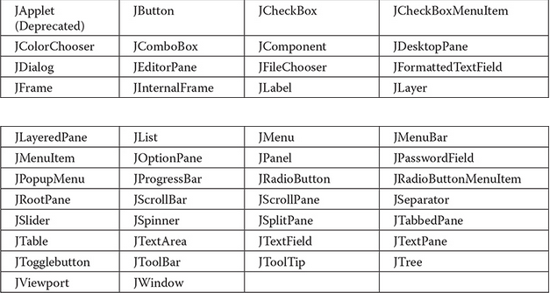
Components
In general, Swing components are derived from the JComponent class. (The only exceptions to this are the four top-level containers.
All of Swing’s components are represented by classes defined within the package javax.swing. ->
Notice that all component classes begin with the letter J. For example, the class for a label is JLabel;

Slide 12
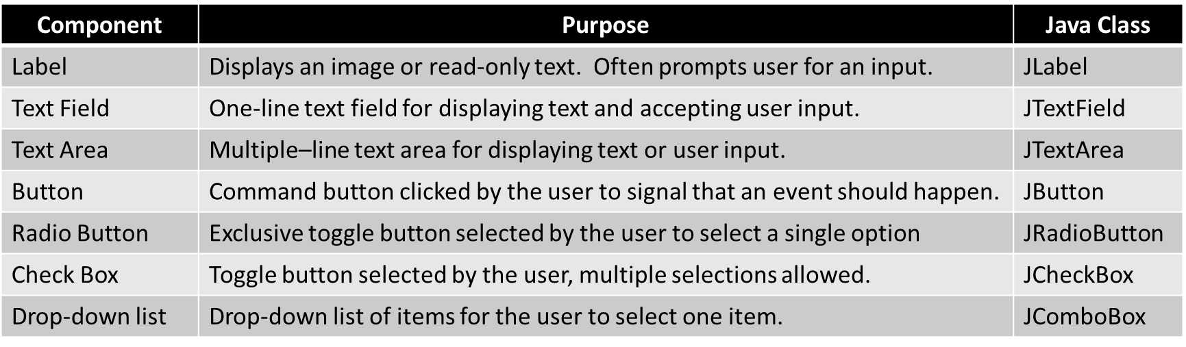
Most Commonly Used Components

Slide 13
Containers
Swing defines two types of containers. They are top-level and lightweight containers.
Examples of the first type, top-level containers: JFrame, JApplet, JWindow, and JDialog.
These containers do not inherit JComponent.
They do, however, inherit the AWT classes Component and Container.
Unlike Swing’s other components, which are lightweight, the top-level containers are heavyweight. This makes the top-level containers a special case in the Swing component library.

Slide 14
Top-Level Containers
A top-level container must be at the top of a containment hierarchy.
A top-level container is not contained within any other container.
Furthermore, every containment hierarchy must begin with a top-level container.
The one most commonly used for applications is JFrame.

Slide 15
Lightweight Containers
The second type of containers supported by Swing are lightweight containers.
Lightweight containers do inherit JComponent. An example of a lightweight container is JPanel, which is a general-purpose container.
Lightweight containers are often used to organize and manage groups of related components because a lightweight container can be contained within another container.
Thus, you can use lightweight containers such as JPanel to create subgroups of related controls that are contained within an outer container.

Slide 16
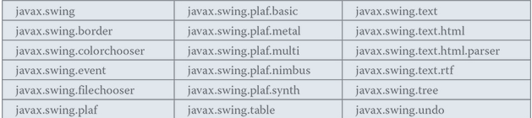
Swing Packages
Swing makes use of many packages. Currently, these are the packages defined by Swing.
Beginning with the JDK 9, the Swing packages are part of the java.desktop module.

Slide 17
The main Swing package
The main package is javax.swing. This package must be imported into any program that uses Swing. It contains the classes that implement the basic Swing components, such as push buttons, labels, and check boxes.
We can use * as a wildcard for all of the classes on that level.
Using * does not include classes on the next level down.
All swing components names begin with a J
So.. We would import javax.swing.JLabel; or javax.swing.*;

Slide 18
GUI Application using Swing
The first step to creating a GUI Application is to create a window.
We will use the JFrame class in the javax.swing package.
All of these are AWT are AWT
Object
Component
Container
Window
Frame
JFrame

Slide 19

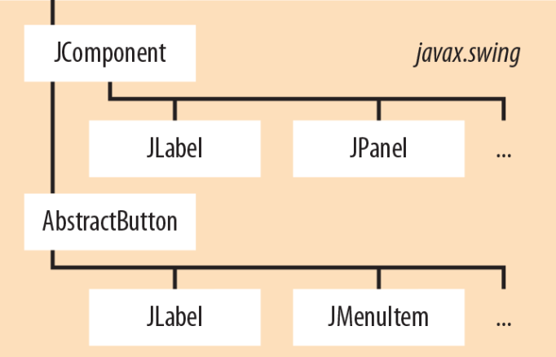
Compoment Hierarchies
As you can see, Container and JComponent sit at the top of the Swing class hierarchy.
You will find several common attributes and methods in these classes as you read the Swing documentation.
JButton
Very Partial List of Swing Components

Slide 20
Your Window Class should extend JFrame
It is called a container class because it contains things like labels, buttons, menus, etc.
It implements all the standard window features such as
a border,
a title bar,
a minimize button,
a close-window button (the "X"),
the ability to resize the window,
And more

Slide 21
Common JFrame Methods
name | function
setTitle | Displays a title in the current window
setSize | Sets width and height dimensions of the window in pixels
setLayout(new Flowlayout()) | Assigns a specified layout manager to the current window
setDefaultCloseOperation(EXIT_ON_CLOSE) | Enables the close-window button (the "X" in the top-right corner) to work properly. Default is to hide the window.
setLocationRelativeTo(null) | Displays the window in the middle of the screen
Add | Adds a specified component to the current window
setVisible(false) | Hides the window
setVisible(true) | Displays the window. Call this after you have added all of the components!

Slide 22
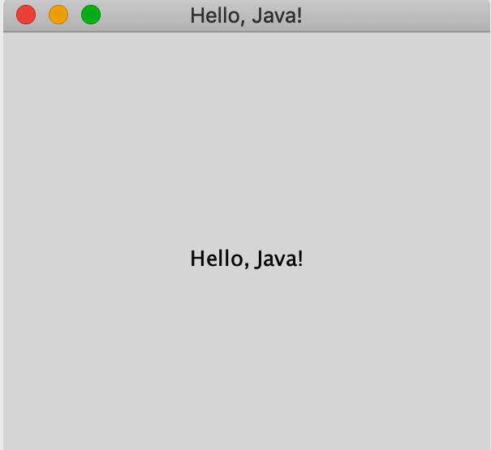
A Simple Window

Slide 23
Code to Create the Simple Window
import javax.swing.*; // for JFrame & Jlabel
public class HelloJavaAgain {
public static void main( String[] args ) {
JFrame frame = new JFrame( "Hello, Java!" );
frame.setDefaultCloseOperation(JFrame.EXIT_ON_CLOSE);
frame.setSize( 300, 300 );
JLabel label = new JLabel("Hello, Java!", JLabel.CENTER );
frame.add(label);
frame.setVisible( true );
}
}
The string passed to the JFrame constructor is the title of the window.

Slide 24
What Else do we know about the Window?
We have completed the process of creating and adding a Window with a JLabel on it. The steps for the Jlabel are:
Instantiate the object.
Set specifics like size or title or text or color or…
Add the object to the JFrame (container)
Set the Window to visible.
This is the foundation of every Swing application.

Slide 25
Closing the Window
Unlike a Frame, a JFrame has some notion of how to respond when the user attempts to close the window
The default behavior is to simply HIDE the JFrame when the user closes the window.
To change the default behavior, you can invoke any of the methods on the following slide.
The most commonly used method is setDefaultCloseOperation(JFrame.EXIT_ON_CLOSE);

Slide 26
setDefaultCloseOperation(int operation);
Operations
DO_NOTHING_ON_CLOSE Don't do anything; require the program to handle the operation in the windowClosing method of a registered WindowListener object.
HIDE_ON_CLOSE (Default): Automatically hide the frame after invoking any registered WindowListener objects.
DISPOSE_ON_CLOSE : Automatically hide and dispose the frame after invoking registered WindowListener objects.
EXIT_ON_CLOSE (defined in JFrame): Exit the application using the System exit method. Use this only in applications.

Slide 27
The Content Pane
JFrames have a content pane, which holds all of the non-menu components. These components are sized and positioned by the layout manager when JFrame's pack() method is called.
As a convenience, add and its variants (remove and setLayout) have been overridden to forward to the contentPane as necessary. This means you can write:
frame.add(child);
And the child will be added to the contentPane. The content pane will always be non-null. Attempting to set it to null will cause the JFrame to throw an exception.
The default content pane will have a BorderLayout manager set on it.

Slide 28
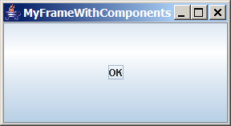
Content Pane Delegation in JDK 1.5 and greater
// Add a button into the frame
frame.getContentPane().add(
new JButton("OK"));
Title bar
// Add a button into the frame
frame.add(
new JButton("OK"));
Content pane

Slide 29
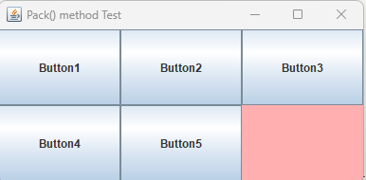
To Change the Background Color of the JFrame
You will need to use getContentPane() to se the background color of your JFrame:
frame.getContentPane().setBackground(Color.PINK);

Slide 30
What does the pack() method do?
Try this test code:
import java.awt.*;
import javax.swing.*;
public class TestPack extends JFrame {
public TestPack() {
setTitle("Pack() method Test");
setLayout(new FlowLayout());
setButton();
// pack(); // calling the pack() method
setDefaultCloseOperation(JFrame.EXIT_ON_CLOSE);
setLocationRelativeTo(null);
setVisible(true);
}
void setButton() {
for(int i=1; i < 6; i++) {
add(new JButton("Button" +i));
}
}
public static void main(String args[]) {
new TestPack();
}
}
***************************************
Try it once with the pack method
commented out, then try it again
using the pack method.

Slide 31

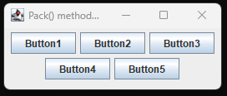

Test
I tried this code without using the pack() method and output was only one button showing:
But then I pulled its sides and got whatever layout I wanted:
When I added the pack method, output was:

Slide 32
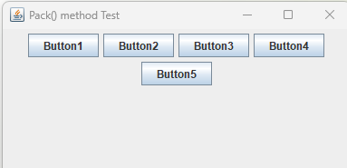

The Point of this Test
Notice that there is no size set on the JFrame.
Once you set the size, packing does its thing differently.
I added a size of width = 400, height = 200: setSize(400, 200);
No packing:
With packing, it changed the width and the height so it could “pack.”:

Slide 33
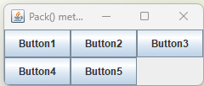
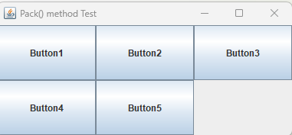
Instead of FlowLayout, I used GridLayout and left the JFrame size.
With packing:
Without Packing:

Slide 34
COLOR in Swing

Slide 35

Color
Most GUI components are comprised of two colors - foreground color is the color of the text, background color is the color of the area behind the text.
Here's how to create a red button with white text:
JButton btn = new JButton("Click Me");
btn.setBackground(Color.RED);
btn.setForeground(Color.WHITE);
And here's what the red-white button looks like:

Slide 36
Color Methods
The setBackground and setForeground methods are standard mutator methods available to most GUI components.
Likewise, getBackground and getForeground methods are standard accessor methods available to most GUI components. Here are their API headings and descriptions:
public Color getBackground()
Returns the component's background color.
public Color getForeground()
Returns the component's foreground color.

Slide 37
Example nethods for a JTextField
JTextField nameBox = new JTextField();
Color originalBackground = nameBox.getBackground();
Color originalForeground = nameBox.getForeground();

Slide 38
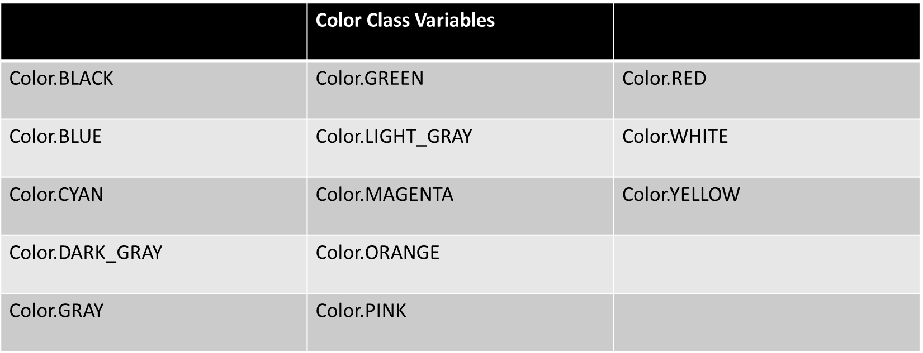
Java.awt.Color Named Constants

Slide 39
Color Objects
To obtain a color that is not in the Color class's list of named constant colors, instantiate a Color object with a specified mixture of red, green, and blue.
Here's the Color constructor call syntax: new Color(<red 0-255>, <green 0-255>, <blue 0-255>)
Each of the three Color constructor arguments is an int value between 0 and 255. The int value represents the amount of color, with 0 indicating no color and 255 indicating the maximum amount of color
For example, this statement sets a button's background color to purple: button.setBackground(new Color(128, 0, 128));

